Slide 1
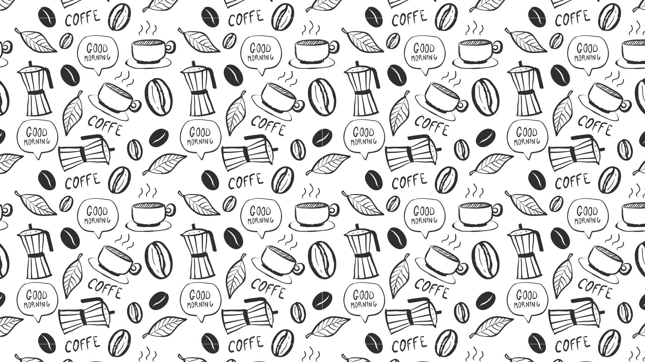

Slide 1
Bright Coffee Shop
Sales Analysis By Hlengie

Slide 2
Total Revenue By Time Of the Day > According to the above charts more revenue is generated in the morning about 48% of the revenue is generated in the morning. > Only 7% of total revenue is generated at night , night sales needs to be promoted to increase revenue.
Row Labels | Sum of QUATITY
Afternoon | 45002
Day | 52071
Morning | 103594
Night | 13803
Grand Total | 214470

Slide 3
Total Revenue By Customer Behaviour >Most od the revenue comes from regular buyers and buyers buying pricey and normal price products, to increase sales and revenue – pricey and normal price products need to be promoted more. > Cheaper products and too expensive products are not making much- sales more promotion and specials can improve sales of these products.
Row Labels | Sum of TOTAL_RECORDS
Cheaper | R12 437,00
Buyer | R5 972,00
Regular | R6 465,00
Normal_Price | R72 065,00
Buyer | R36 854,00
Regular | R35 211,00
Pricey | R46 644,00
Buyer | R32 257,00
Regular | R14 387,00
Too_Expensive | R17 970,00
Buyer | R12 076,00
Regular | R5 894,00
Grand Total | R149 116,00

Slide 4
Total Revenue By StoreLocation > Three best selling stores are Hells Kitchen follwed by Astoria then Lower Manhattan >Lower Manhattan need to do more promotions and specials in order to improve sales.
Count of TOTAL_REVENUE | Column Labels
Row Labels | Astoria | Hell's Kitchen | Lower Manhattan | Grand Total
Coffee | R20 025,00 | R20 187,00 | R18 204,00 | R58 416,00
Grand Total | R20 025,00 | R20 187,00 | R18 204,00 | R58 416,00

Slide 5
Revenue By Product Category & Store Location > Five top selling products are Drinking chocolate, Coffee, Tea, Loose tea and Bakery. > Drinking chocolate generates more revenue across all 3 best selling shops > Loose tea generates less revenue at Astoria so the need to promote it more.
Count of TOTAL_REVENUE | Column Labels
Row Labels | Bakery | Coffee | Drinking Chocolate | Loose Tea | Tea | Grand Total
Astoria | 33 |  | 1089 | 307 |  | 1429
Hell's Kitchen |  |  | 1005 | 450 |  | 1455
Lower Manhattan |  | 497 | 789 | 331 | 532 | 2149
Grand Total | 33 | 497 | 2883 | 1088 | 532 | 5033

Slide 6
Revenue By Hour Intervals >Astoria generates more revenue around 7:00 to 10:00 and less revenue from 11:00 am to 20:00 pm. >Hells Kitchen generates more revenue from 8:00 am to 10:00 am and less revenue at 20:00 pm. > Lower Manhattan perfoms better from 7:00 to 10:00 am and perfoms worst from 19:00 to 20:00 pm. >Aftenoon and night sales needs to be promoted across all stores
Row Labels | Astoria | Hell's Kitchen | Lower Manhattan | Grand Total
06:00:00.000 | 0,00% | 1,12% | 1,96% | 3,08%
07:00:00.000 | 2,80% | 2,32% | 3,88% | 9,01%
08:00:00.000 | 3,33% | 4,63% | 3,88% | 11,84%
09:00:00.000 | 3,41% | 4,54% | 3,97% | 11,91%
10:00:00.000 | 3,55% | 4,67% | 4,22% | 12,44%
11:00:00.000 | 2,29% | 2,41% | 1,85% | 6,55%
12:00:00.000 | 2,31% | 1,64% | 1,90% | 5,84%
13:00:00.000 | 2,32% | 1,76% | 1,77% | 5,84%
14:00:00.000 | 2,23% | 1,85% | 1,92% | 5,99%
15:00:00.000 | 2,30% | 1,68% | 2,05% | 6,02%
16:00:00.000 | 2,41% | 1,80% | 1,88% | 6,10%
17:00:00.000 | 2,28% | 1,89% | 1,69% | 5,86%
18:00:00.000 | 2,32% | 1,75% | 0,96% | 5,03%
19:00:00.000 | 2,39% | 1,61% | 0,08% | 4,09%
20:00:00.000 | 0,00% | 0,35% | 0,05% | 0,40%
Grand Total | 33,93% | 34,02% | 32,04% | 100,00%

Slide 7
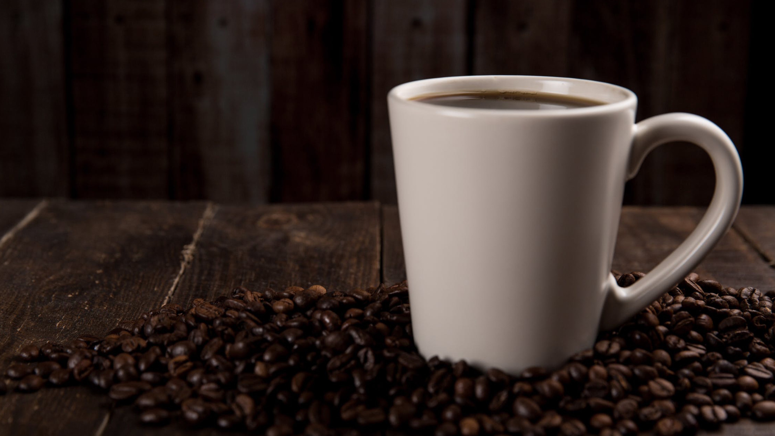

Slide 2
OUR BIG IDEA
Bright Coffee Shop mission is to become the recognized leader in its target market for providing an outstanding selection of premium bagged coffees and coffee drinks.

Slide 8
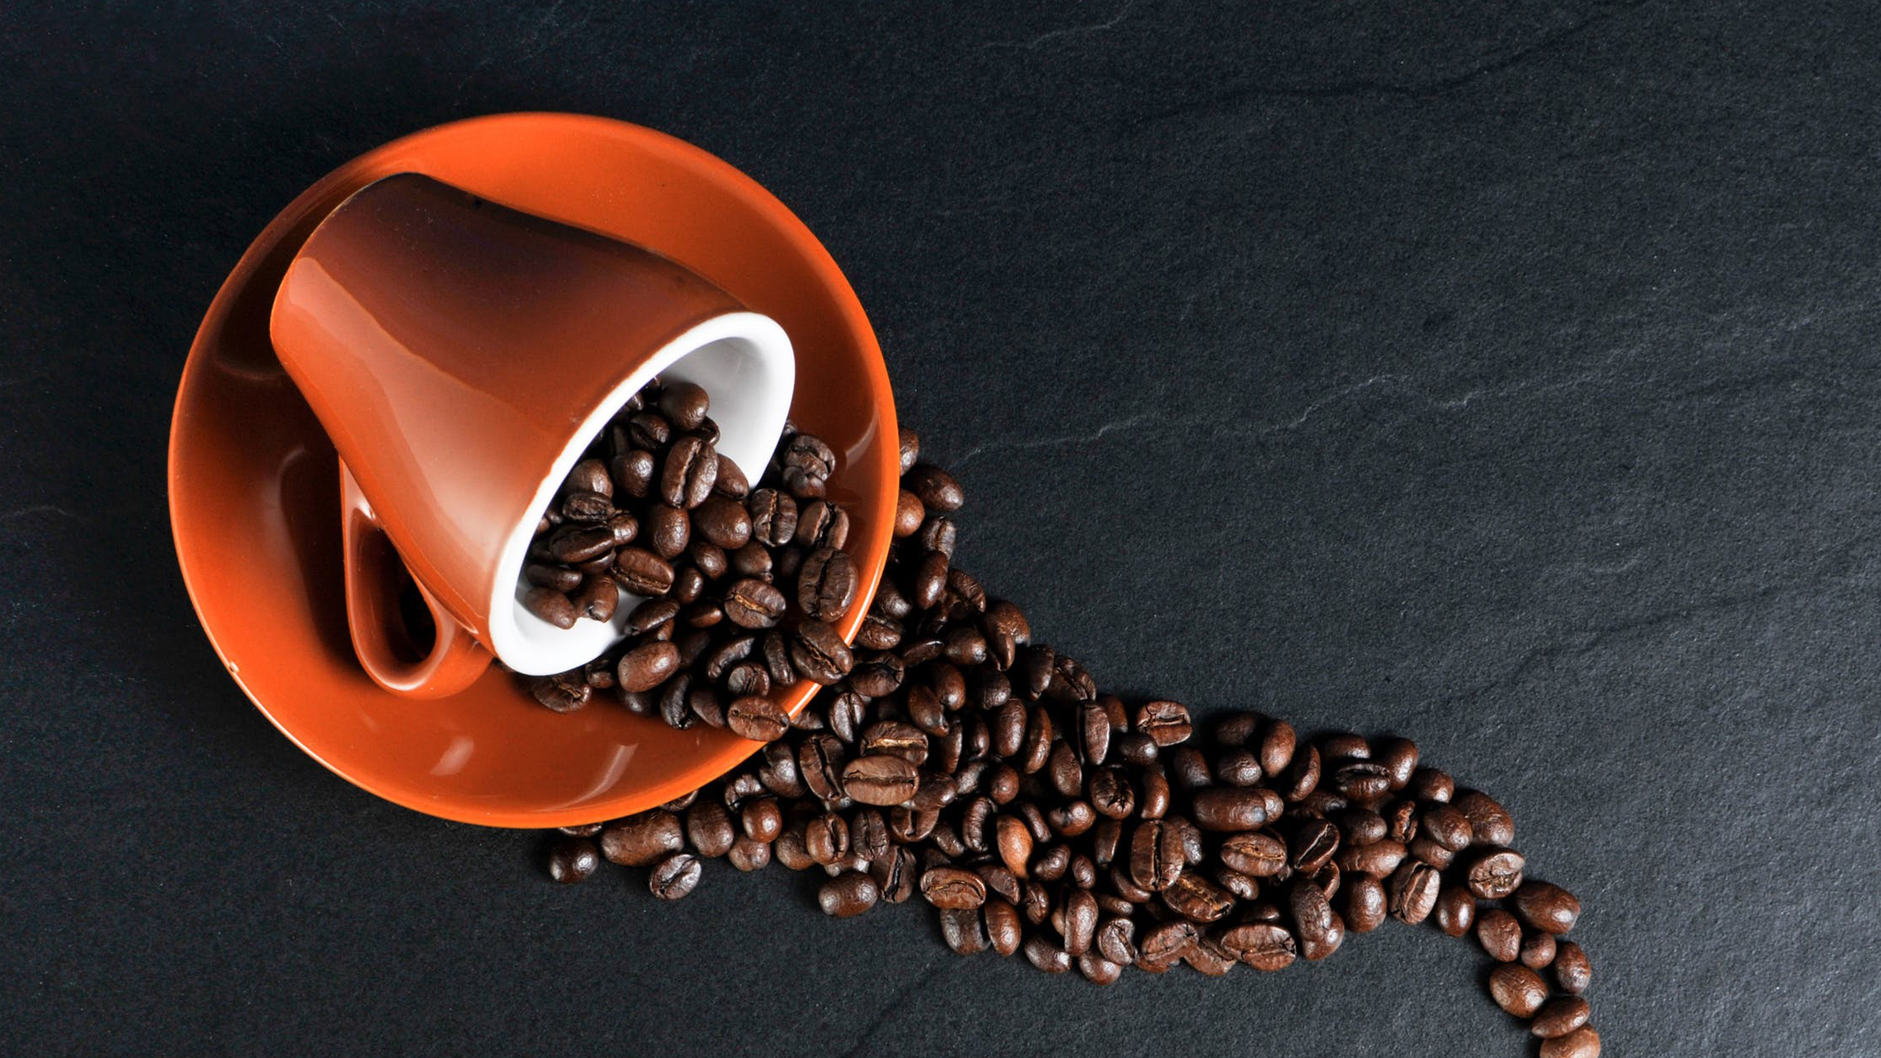

Slide 5
OUR PREMIUM OFFERINGS
Drinking Chocolate
Coffee
Tea

Slide 9

Slide 15
THANK YOU!
CONTACT US AT:
Bright Coffee Shop
Brightcoffee@gmail.com
0114734564

